Slide 1

Particle Swarm Optimization (PSO)
Group Members:
Syeda Areesha Najam
Shalin Amir Ali
Sana Fatima
https://www.pinterest.com/pin/651825746046910978/

Slide 2
What is PSO?
A population based stochastic algorithm based on metaheuristic approach.
Basic algorithm as proposed by Kennedy and Eberhart (1995)
Used in numerical optimization problems.
An inspiration from social foraging behaviors of animals.
Also classified as swarm intelligence algorithm like,
bacterial foraging algorithm
ant colony algorithm etc.
Example: predicting score of a football team using a math equation.

Slide 3
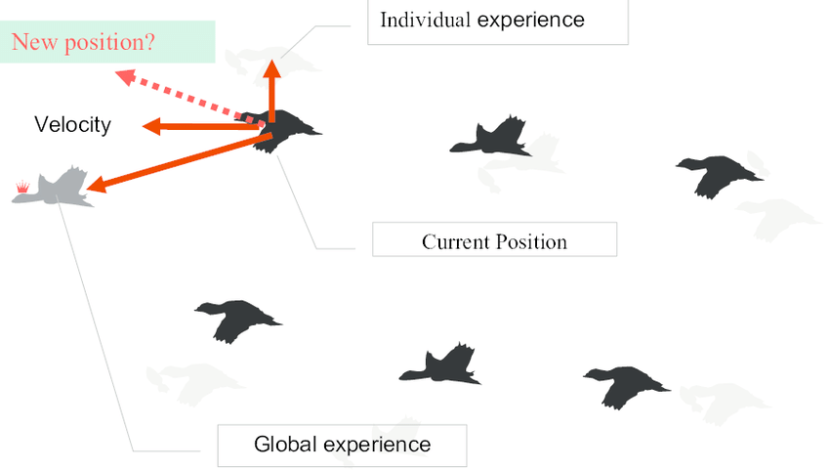
https://www.researchgate.net/figure/PSO-schematic-diagram_fig1_221910984

Slide 4
Important concepts and functions in PSO. (1/4)
Concepts:
As it is a population based method, it works iteratively until the terminal point is reached
Uses many particles (referred to as swarm) which are moving in search for best solution
Each particle has its fitness value which is evaluated by the fitness function
All the particle has certain velocities which directs the flying of the particles
Particles fly through the space by following the current optimum particles

Slide 5
Important concepts and functions in PSO. (2/4)
How does it work or functions?
It starts with a group of random particles.
Searches for the optimal value by updating generations.
Particles move in the solution space and are evaluated according to a fitness criteria.
After every iteration, the "best" values of each particle is updated i.e.
Pbest (personal best)
Gbest (global best)

Slide 6
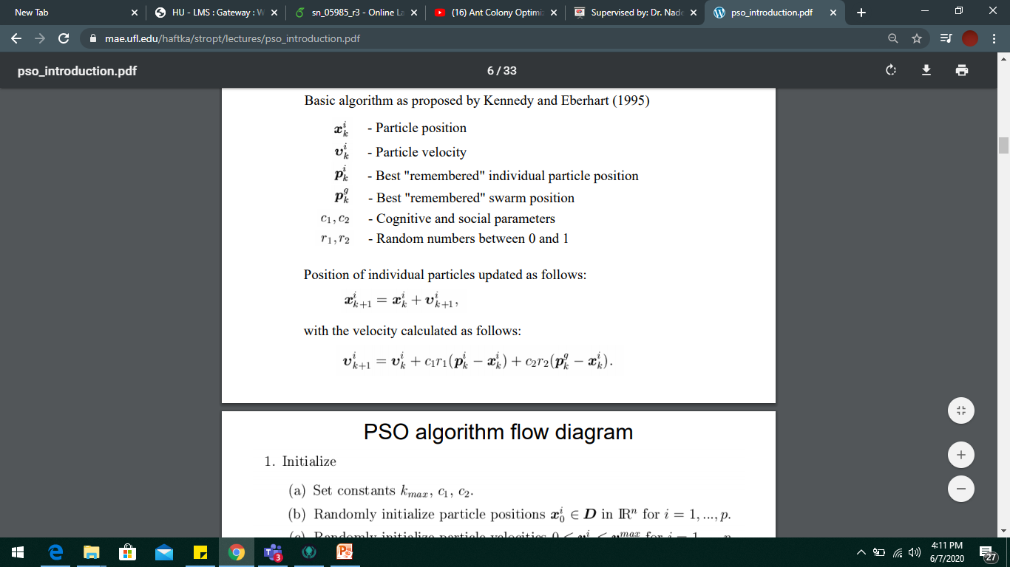
Important concepts and functions in PSO. (3/4)
Some basic equations:
Position of individual particles updated as follows:
With the velocity calculated as follows:

Slide 7
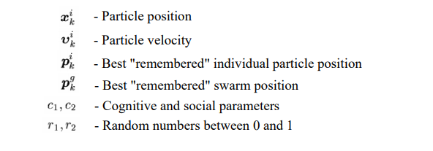
Important concepts and functions in PSO. (4/4)
Where,

Slide 8
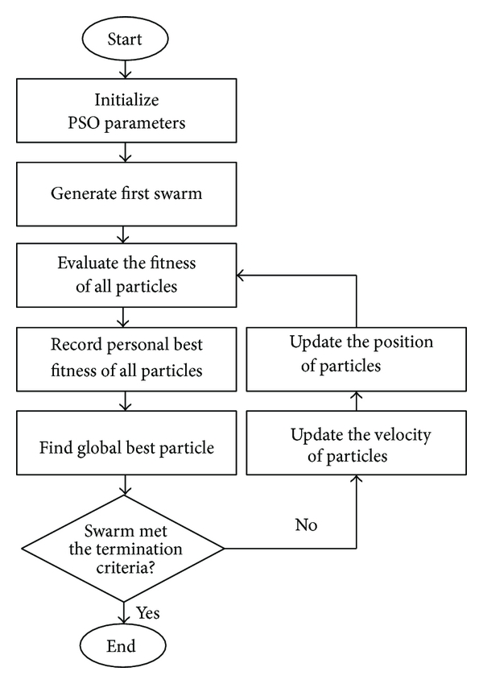
PSO Flowchart: An approach towards PSO problem

Slide 9
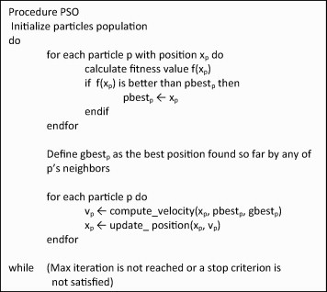
PSO Algorithm:
Update:
Fitness value
Personal best value of each particle
Global best value
Calculate new velocity and position of each particle to achieve the global best function value in every iteration.

Slide 10
Theoretical Analysis (time complexity)
Worst Case : O(n²)
O(n)
O(1)
O(1)
O(1)
O(1)
O(n)
O(1)
O(1)
O(n)

Slide 11
Implementation of PSO

Slide 12
Experimental Analysis

Slide 13
References:
https://www.researchgate.net/figure/The-pseudocode-of-the-PSO-algorithm_fig8_274460300
https://www.hindawi.com/journals/tswj/2014/973093/fig1/
https://pt.slideshare.net/MohamedTalaat9/digital-image-forgery?next_slideshow=1
https://slideplayer.com/slide/12229714/

